Slide 1

Natural Language Processing
Recitation Class

Slide 2
Recap
Language Model: A system that predicts the next word
Recurrent Neural Network: A family of neural networks that:
Take sequential input of any length
Apply the same weights on each step.
Can optionally produce output on each step
Problems: Vanishing and exploding gradient
LSTM: Solution of Vanishing gradient
Gradient Clipping: Solution for Exploiding gradient
GRUs are similar to Long Short-Term Memory (LSTM)
Machine Translation
Seq Seq Neural machine translaton

Slide 3
So, is Machine Translation solved?
The bottleneck problem arises from the fixed-size representation of the source sentence. If the source sentence is very long or contains complex information, it's challenging for the encoder to compress all the relevant information into this fixed-size vector. As a result, some information may be lost or not adequately represented in the context vector.

Slide 4

Solution to Bottleneck problem?
Attention provides a solution to the bottleneck problem. • Core idea: on each step of the decoder, use direct connection to the encoder to focus on a particular part of the source sequence

Slide 5
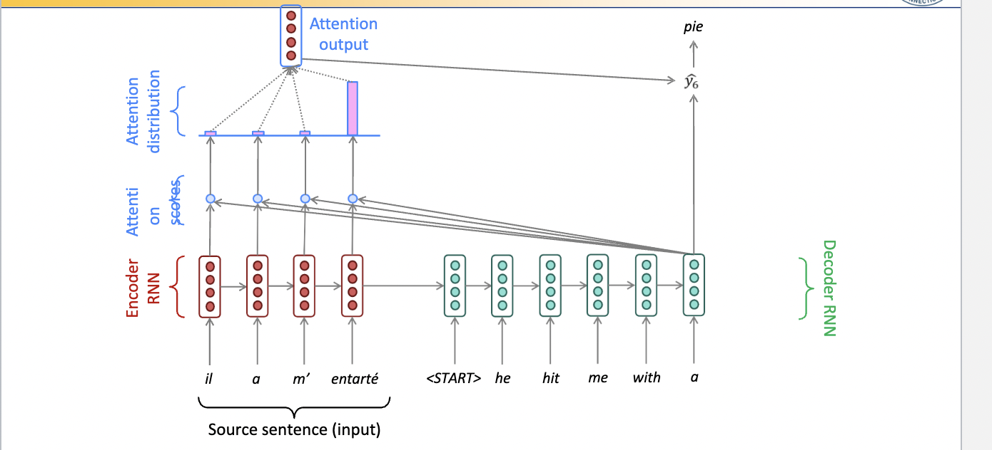
Seq to seq with Attention

Slide 6
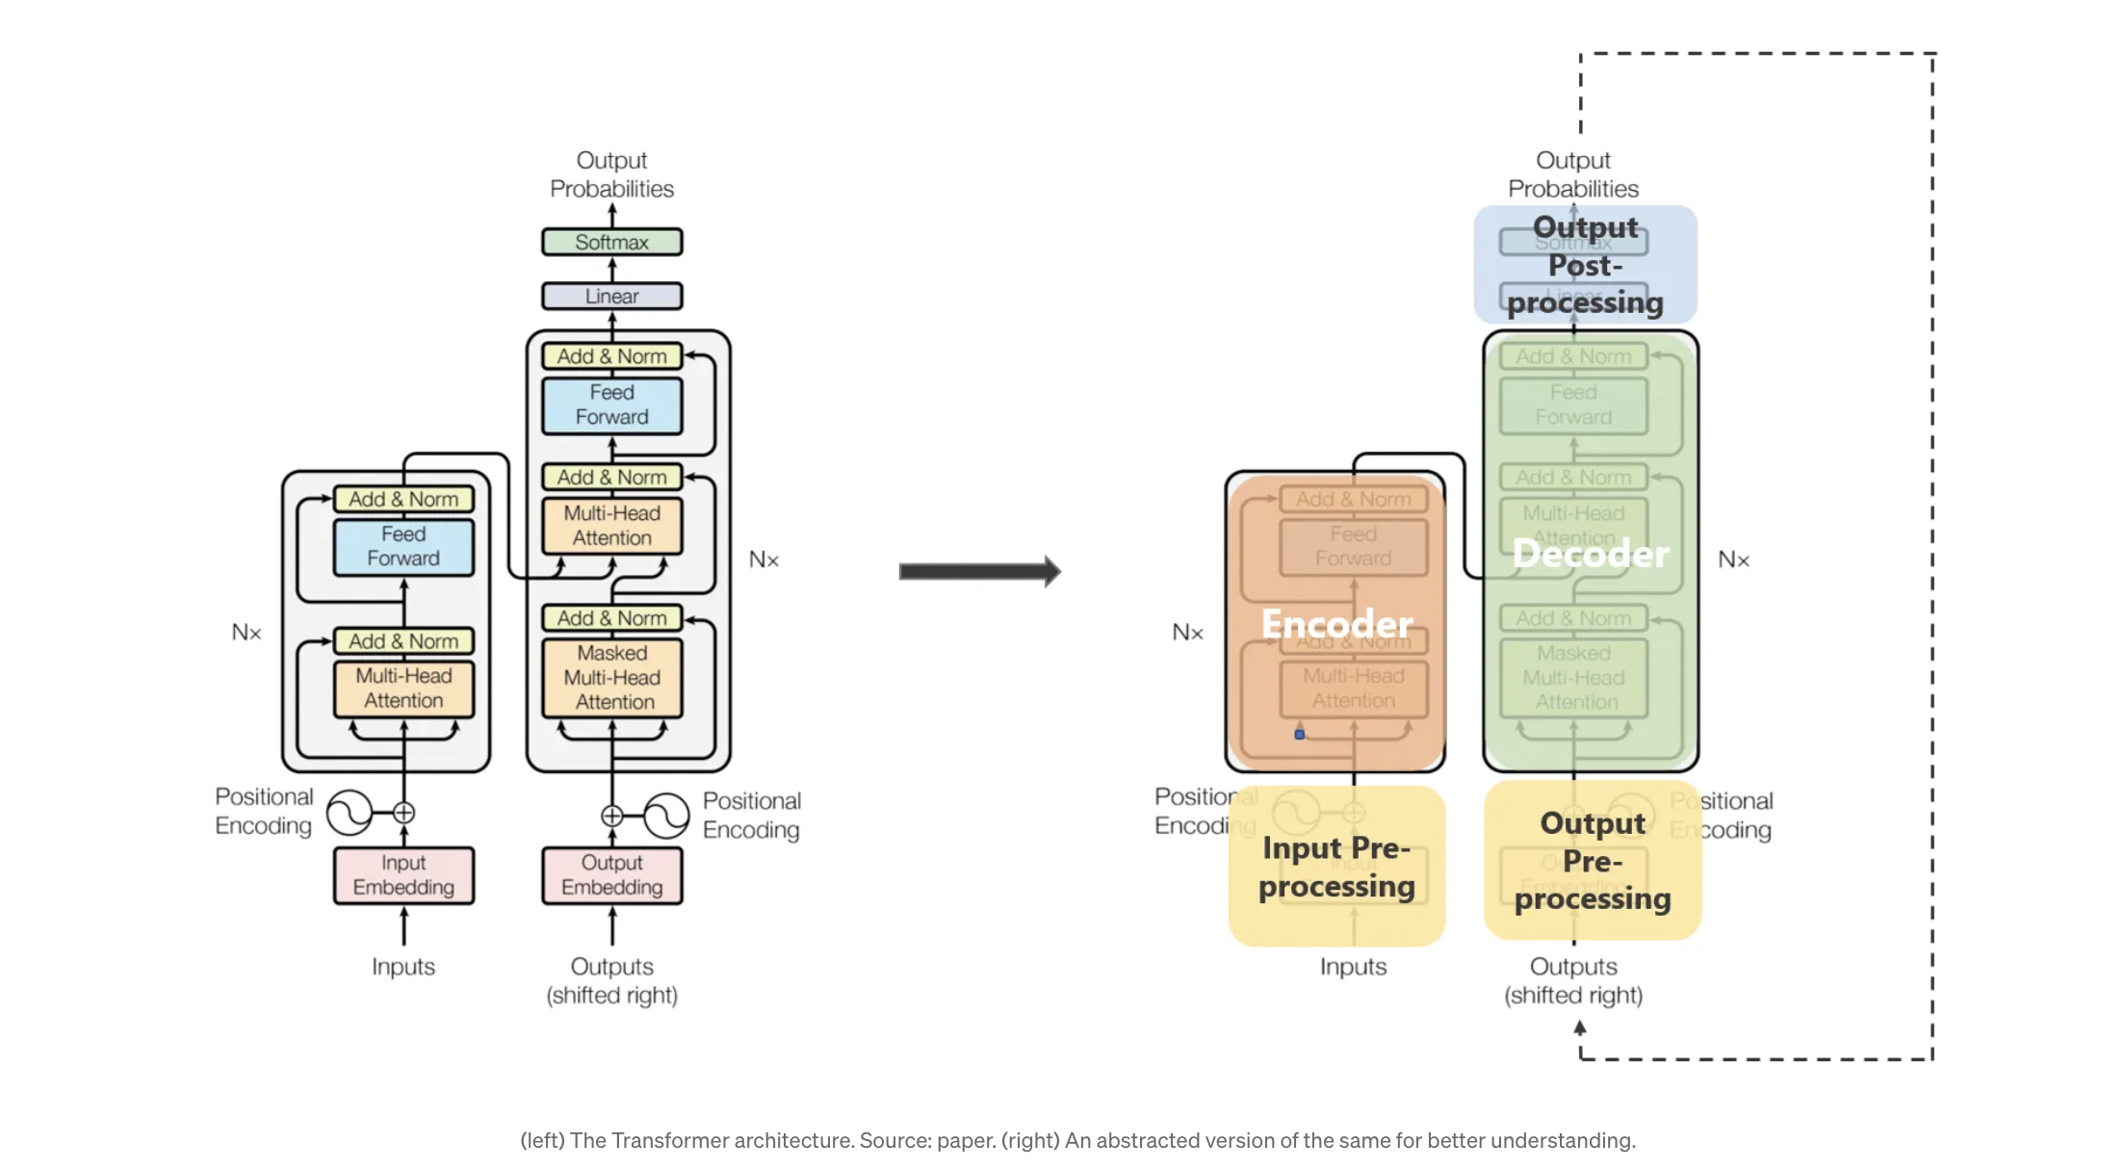

Slide 7
Key components and features of the transformer architecture:
Attention Mechanism:
The attention mechanism allows the model to focus on different parts of the input sequence when making predictions. It captures relationships between words by assigning different weights to different parts of the sequence.
Encoder-Decoder Structure:
The transformer architecture is composed of an encoder and a decoder. In NLP tasks, the encoder processes the input sequence, and the decoder generates the output sequence.
Self-Attention:
Self-attention allows each word in the input sequence to attend to all other words. This enables the model to capture dependencies and relationships between words regardless of their positions in the sequence.
Multi-Head Attention:
To capture different types of relationships and patterns, transformers use multiple attention heads in parallel. Each head focuses on different aspects of the input sequence.
Positional Encoding:
Since transformers don't inherently understand the order of the input sequence, positional encodings are added to provide information about the positions of words in the sequence.

Slide 8
Pretraining
In Natural Language Processing (NLP), pretraining involves training a model on a large corpus of text data to learn general language representations. Pretraining in NLP typically uses unsupervised or self-supervised learning techniques to train models like BERT (Bidirectional Encoder Representations from Transformers), GPT (Generative Pretrained Transformer), and their variants.

Slide 9
Pretraining for three types of architecture
Decoders (Language Models):
Use Cases: Ideal for text generation tasks, but can't condition on future words.
Examples: GPT-2, GPT-3, LaMDA.
Pretraining Focus: Language models like GPT series focus on autoregressive language modeling, predicting the next word based on preceding words, enabling coherent and contextually relevant text generation.

Slide 10
2. Encoders (Bidirectional Context):
Use Cases: Provide bidirectional context, capable of conditioning on future words.
Examples: BERT and its variants like RoBERTa.
Pretraining Approach: Encoders like BERT capture bidirectional context through tasks like masked language modeling, understanding relationships between words in both directions.

Slide 11
3. Encoder-Decoders (Hybrid Approach):
Use Cases: Incorporate the strengths of both encoders and decoders.
Examples: Models like Transformer, T5, Meena.
Pretraining Strategy: These architectures leverage bidirectional context while also enabling text generation and conditioning on future words, aiming to amalgamate the benefits of both encoder and decoder architectures.

Slide 12
Pretraining Process
Encoder Pretraining (Similar to BERT):
Task: Train the encoder to capture bidirectional context and relationships between words in the source sequences.
Method: Utilize a masked language modeling task, similar to BERT.
Example: Given a source sentence, mask certain words and train the encoder to predict the masked words based on the context of the sentence.
Decoder Pretraining (Similar to GPT):
Task: Train the decoder to generate sequences and predict the next word in a sequence based on the preceding context.
Method: Autoregressive language modeling task, similar to GPT.
Example: Given a target sentence, train the decoder to predict the next word in the sequence based on the words preceding it.

Slide 13
Question Answering
Question answering (QA) refers to the process of providing accurate and relevant responses to questions posed in natural language. In the context of natural language processing (NLP), QA involves building systems or models that can comprehend human queries and generate appropriate answers based on available information.

Slide 14
Question answering: a taxonomy
Question answering (QA) in the field of natural language processing (NLP) can be understood as a taxonomy, a hierarchical classification, or categorization of various methods, approaches, and techniques utilized to enable machines to comprehend and respond to human questions in a natural language format.
This taxonomy comprises different categories or branches that encompass the diverse strategies and technologies employed in QA systems. It can include:
Question Understanding: System parses, identifies entities, intents, and context of the question.
Information Retrieval: Searches relevant data from datasets or knowledge bases.
Answer Generation: Uses retrieved information to formulate accurate responses.

Slide 15
Techniques for QA in NLP:
Rule-Based Systems: Use predefined rules and linguistic patterns for responses.
Information Retrieval Techniques: Keyword matching, indexing, and search algorithms to find answers.
Machine Learning Models: e.g., BERT, GPT, trained on large text corpora for accurate contextual understanding and response generation.

Slide 16
Beyond textual QA problems
"Beyond textual QA problems" refers to expanding the scope of question answering (QA) beyond traditional text-based questions and answers, delving into more complex or diverse problem domains where the answers might not solely rely on textual information. This expansion involves addressing QA challenges in various domains beyond simple text understanding.

Slide 17
Here are some aspects:
Multimodal QA: This involves combining different modalities such as text, images, videos, or audio to answer questions. For instance, answering questions about the content of an image or video, or generating textual descriptions from visual inputs.
Interactive QA: Moving beyond static queries to dynamic interactions, where systems engage in conversations or iterative exchanges to gather more context and provide better answers over multiple turns.
Knowledge Graph-based QA: Utilizing structured knowledge graphs or databases to answer questions that require relational or graph-based reasoning. This involves navigating relationships between entities rather than relying solely on textual information.
Scientific and Domain-Specific QA: Addressing QA challenges in specialized domains like medicine, law, or science, where the questions might involve specialized terminologies, concepts, or domain-specific knowledge.

Slide 18
Reading comprehension
Reading comprehension is the ability to understand, interpret, and extract meaning from written text. It involves comprehending the content, context, and nuances of a passage, document, or piece of writing. This skill encompasses several key elements:
Understanding Text
Vocabulary and Language Understanding
Inference and Reasoning
Contextual Understanding
Summarization and Synthesis

Slide 19
Stanford Question Answering Dataset (SQuAD)
The Stanford Question Answering Dataset (SQuAD) is a widely used benchmark dataset in the field of natural language processing (NLP), specifically designed for testing and evaluating machine reading comprehension and question answering systems.
SQuAD consists of a large collection of real-world reading comprehension passages, extracted from a variety of sources such as Wikipedia articles, along with a set of question-answer pairs created by human annotators.

Slide 20
Key features of SQuAD include:
Realistic Texts: The dataset contains diverse and authentic articles that cover various topics, ensuring a broad range of textual content for comprehension.
Questions and Answers: Each passage in SQuAD is associated with a set of questions that are formulated based on the content of the passage. These questions have corresponding human-generated answers, making them a valuable resource for evaluating the ability of NLP models to understand and answer questions accurately.
Training and Evaluation: SQuAD is commonly used for training and evaluating machine learning models, particularly those focused on reading comprehension and question answering tasks. Researchers and developers use this dataset to assess the performance of their models in understanding context, generating accurate answers, and handling various question types.

Slide 21
Evaluation metrics used in the Stanford Question Answering Dataset (SQuAD)
Evaluation metrics used in the Stanford Question Answering Dataset (SQuAD) are Exact Match (EM) and F1 score, which are common in question answering tasks.
Here's a breakdown of these evaluation metrics in the context of SQuAD:
Exact Match (EM): This metric computes a binary score (0 or 1) to determine if the predicted answer exactly matches the ground truth answer. If the predicted answer precisely matches the reference answer, it receives a score of 1; otherwise, it gets a score of 0. EM is a strict metric that requires an exact match between the predicted and true answers.
F1 Score: The F1 score is a measure of accuracy used in classification tasks. In the context of SQuAD, it's applied to evaluate the performance of question answering models. It considers both precision and recall.
Precision: It is the ratio of the number of shared words between the predicted and true answers to the total number of words in the predicted answer.
Recall: It is the ratio of the number of shared words between the predicted and true answers to the total number of words in the ground truth (true) answer.

Slide 22
Example for EM
Passage: "The cat is sitting on the mat." Ground Truth Answer: "on the mat" Predicted Answer: "on mat"
For EM:
Ground Truth Answer: "on the mat"
Predicted Answer: "on mat"
In EM, an exact match is required between the predicted and ground truth answers.
The predicted answer "on mat" does not exactly match the ground truth answer "on the mat." There's a difference due to the missing space in the predicted answer. Therefore, the EM score is 0 (no exact match).

Slide 23
Example for F1
Precision:
Shared words between predicted and ground truth answer: 2 ("on”, “mat”)
Total words in predicted answer: 2 ("on", "mat")
Precision = Shared words / Total words in predicted answer = 2 / 2 = 1
Recall:
Shared words between predicted and ground truth answer: 2 ("on”, “mat”)
Total words in ground truth answer: 3 ("on", ”the”, "mat")
Recall = Shared words / Total words in ground truth answer = 2/ 3 = 0.67
F1 Score:
F1 Score = 2 * (Precision * Recall) / (Precision + Recall)
F1 Score = 2 * (1 * 0.67) / (1+ 0.67) = 0.80

Slide 24
Other question answering datasets
HotpotQA: It focuses on answering questions that require gathering information from multiple parts of a passage or document. The dataset contains questions that demand reasoning over disjoint pieces of text to arrive at an answer.
TriviaQA: This dataset involves answering trivia questions that require both knowledge and comprehension. It includes both reading comprehension sections and factual questions.
NarrativeQA: It consists of summaries from books and a set of multiple-choice questions designed to test comprehension. The dataset includes a variety of questions, including those that require reasoning over multiple sentences or paragraphs.

Slide 25
BiDAF (Bidirectional Attention Flow)
BiDAF (Bidirectional Attention Flow) is a popular neural network architecture designed for machine comprehension and question answering tasks. It was introduced in a research paper by Minjoon Seo et al. in 2016 and has been influential in the field of natural language processing.
The BiDAF model is based on deep learning techniques and focuses on bidirectional attention mechanisms to better understand and process textual data, particularly for tasks like reading comprehension and question answering.

Slide 26
Here's an overview of the key components and workings of the BiDAF model:
Word Embeddings: BiDAF starts by representing words as dense vectors called embeddings. These embeddings capture semantic and contextual information about words in a continuous vector space.
Character Embeddings: It also utilizes character-level representations to capture morphological information, especially for rare or out-of-vocabulary words.
BiLSTM (Bidirectional Long Short-Term Memory): BiDAF employs a bidirectional LSTM network to model the context from both directions (forward and backward). This allows the model to capture contextual information by processing the input sequence in both forward and backward directions.

Slide 27
Continuation:
4. Attention Mechanism: The key innovation of BiDAF is the attention mechanism, which enables the model to focus on relevant parts of the text when answering questions. It uses attention weights to determine the importance of each word in the context with respect to the question.
5. Modeling Layer: BiDAF combines information from different LSTM layers and attention mechanisms to create a more comprehensive understanding of the text. This modeling layer refines the contextual information obtained from the attention mechanism.
6. Output Layer: Finally, the model produces an output by predicting the start and end positions of the answer span within the given passage. It selects the span of text that is most likely to answer the question.

Slide 28

Thank you.

